Slide 1
Predicting Student Outcomes
Gwen Rino
Dhiraj Khanna, mentor
October 2017
Notes:
Thank you, special thanks to Dhiraj.
I come to data science as an educator, 12 years as a classroom teacher and another 10 as a school administrator.
Question: How can data science help answer difficult questions in the education field?

Slide 2
who is at high risk of failing?
Can we predict
Notes:
As an educator, I'd love to be able to predict which students are at high risk of failing.
Opportunity for early intervention, provide academic and/or social-emotional support

Slide 3
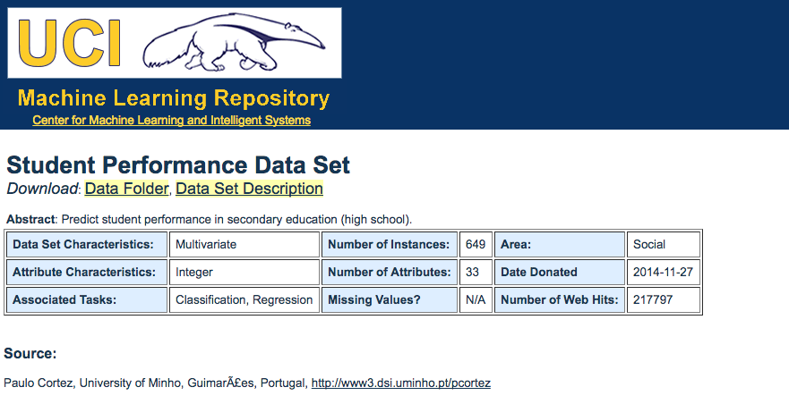
Notes:
Datasets collected at two secondary schools in Portugal in 2008. They record students' grades in math or Portuguese, and also thirty other demographic and social variables
-student's sex, age
-mother's level of education
-weekend alcohol consumption
-romantic relationship

Slide 4
Data wrangling
Data was very clean, no missing values, in tidy format
Two different files, one Portuguese grades, one math grades
Combined the datasets into one with a new variable, “course”
Also created a second version of the dataset in which G3 was recast from a numeric to a factor variable “outcome” with two levels, “pass” and “fail”

Slide 5
using midterm grades as predictors?
Can we predict who is at risk of failing
Notes:
Typically: students who are doing well at midterm get high final grades, students who are failing at midterm are likely to fail the course. So midterm grades should be good predictors. Test this.

Slide 6
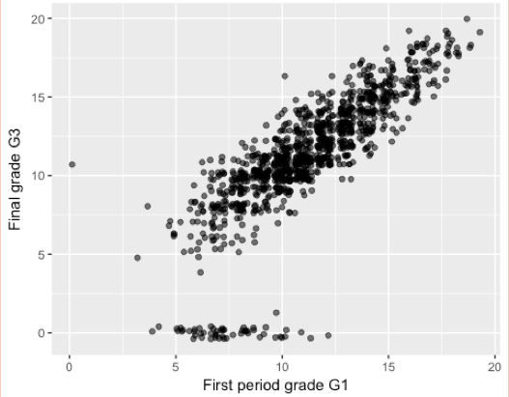
A linear model predicts most but not all students’ final grades.
Can a non-linear model do any better?
Notes:
This graph shows the strong linear relationship between interim grade G1 and final grade G3 for most students. (G2 is similar)
Most of the time, you can predict a student's final grade just by looking at her midterm grade. But you can't predict dropouts.
I explored the linear model in a lot of detail, running it on training and test datasets, building diagnostic plots, examining R-squared values.
Maybe because the situation is so intuitively clear, I learned a lot about linear regression just by playing around.
For example, diagnostic Normal Q-Q plot shows that the residuals in the lowest quantile are not normally distributed, which is easy to see and understand just by looking at this scatterplot.
Eventually I came to the big question: Is there another kind of model that could more accurately predict failure?

Slide 7
Explorations in classification
CHALLENGES &
SOLUTIONS
TYPES OF MODELS
Which variables should I consider? Forward and backward stepwise selection (package “leaps”)
How can I balance the dataset? Over- and undersampling, make synthetic minority class data (package “ROSE”)
How can I compare the accuracy of different models? AICs, AURC, confusion matrixes
Logistic regression
Decision trees (package “rpart” and “rpart.plot”)
Random forest (package “randomForest”)
Notes:
This was pretty exhaustive exploration, learning as I went.
I explored different combinations of variables as predictors
I learned techniques for balancing the dataset, which was necessary because only ~10% of the observations were in the minority class ("fail")
I tried three different types of models and learned how to compare the accuracy of the predictions of each type.
I created and studied literally dozens and dozens of models.
MOST INTERESTING TO ME
- Impact of balancing the dataset (explain oversampling, if there's time)
- Understanding confusion matrixes (weighing the high value of "catching" all the students in the minority class against the relatively low cost (in terms of student outcomes) of "false fails" -- these students would get extra academic help that they would not have needed in order to pass

Slide 8
Two effective classification models
MODEL | INPUT | “FAIL” CORRECTLY PREDICTED | “PASS” CORRECTLY PREDICTED | CONSIDERATIONS
Logistic regression Data balanced by undersampling | G1 and G2 | 96.0% | 93.2% | High accuracy. Output is opaque for most users; requires professional interpretation.
Decision tree Data balanced by both over- and undersampling | G1 and G2 | 96.0% | 93.2% | High accuracy. Output is intuitive and easy to understand.
Notes:
These were the best two models. In both cases, the input variables were just G1 and G2. I actually found another decision tree model with the same accuracy as this one, but because of the value of parsimony the simpler model is better.

Slide 9
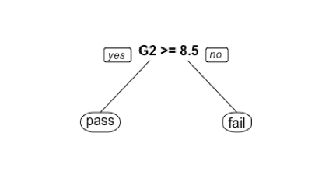
The best predictive models use only G1 and G2 as predictors. All the other variables have no impact on the effectiveness of the models.
Notes:
After all this analysis, the result is really no different than what we could intuit from the linear relationship we looked at in the beginning.
The best predictor of a student's final grade is his or her midterm grades.

Slide 10
without using midterm grades as predictors?
Can we predict who is at risk of failing
Notes:
This would be very desirable for educators!
Midterm is late to intervene.
Besides, as discussed, educators already know that a student who is failing at midterm is a high risk of failing the course.

Slide 11
NO
Notes:
Turns out that sex and parent level of education and alcohol use and romantic relationship and previous failed courses... no combination of variables from this dataset is predictive. Must have midterm grades.
This was also the conclusion of the authors of the original paper.

Slide 12
without using second midterm grades as predictors?
Can we predict who is at risk of failing
Notes:
Well, maybe I could build a model that could predict failure after just G1 instead of G1 and G2.
This would have the advantage of getting help to students at risk of failing earlier in the term.

Slide 13
Predicting student outcomes without second midterm grades
MODEL | INPUT | “FAIL” CORRECTLY PREDICTED | “PASS” CORRECTLY PREDICTED | CONSIDERATIONS
Logistic regression Data balanced by undersampling | G1 # of previous failures course (math or Portuguese) | 92.0% | 84.7% | In exchange for an earlier prediction, we lose accuracy overall and we overpredict failure. Some students will receive interventions even though they would pass without them.
Notes:
Input: G1, number of previous failures, course (math or Portuguese)

Slide 14
Summary
With knowledge of students’ midterm grades, failure is predictable
It is possible to make meaningful predictions early in the term
Demographic and social information in this dataset is not predictive of final grades
Formal data analysis isn’t required for educators to know which students are most in need of interventions
More “pass” students will be misclassified and so will receive unnecessary interventions
Consider other factors?
Family income, food security, incarcerated parent, drug use, pregnancy/parenting, home language…

Slide 15
Thank you!

